Slide 1


How to handle an awkward situation?

Slide 2
Which member of your family…
never gets off the phone?
is always taking things without asking?
never helps around the house?
never switches the lights off?
is always leaving things everywhere?
never tidies up?
plays loud music?
doesn’t let you stay out late?
is always there for you?
helps you with your homework?

Slide 3


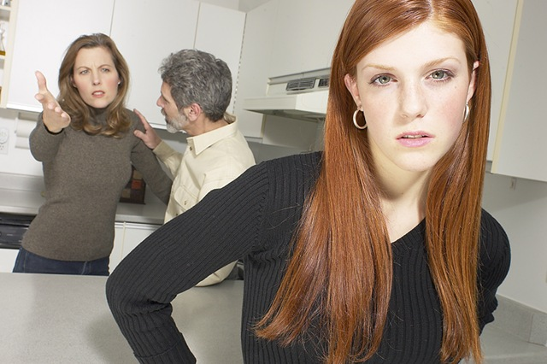
?????

Slide 4

Parents interfere in the relationships with my friends

Slide 5
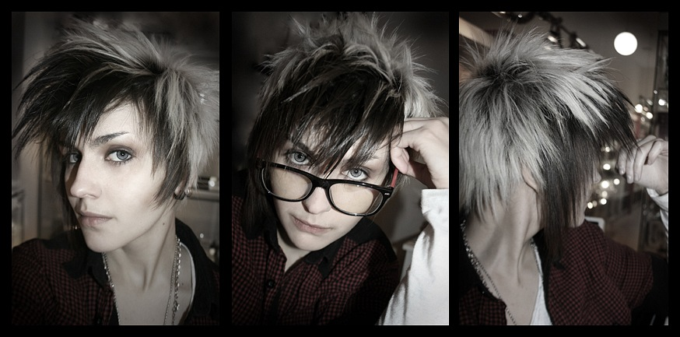
Parents don’t like my hair cut

Slide 6


Parents don’t like the music I listen to

Slide 7


Parents think I’m lazy

Slide 8


Parents think I waste much time with my gadgets

Slide 9

Parents try to solve my personal problems without me

Slide 10

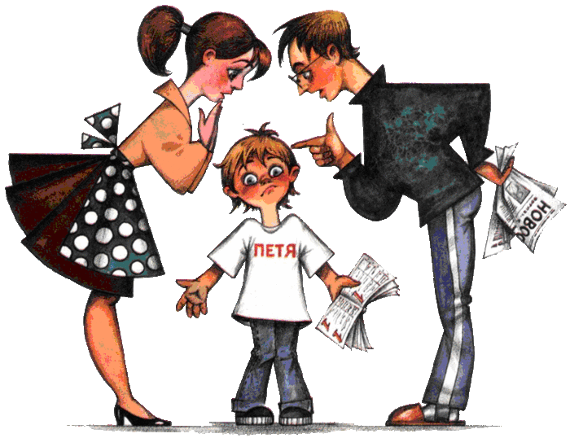
Parents think I can have better marks at school

Slide 11

Parents break their promises

Slide 12
Fill in the gaps with the correct forms of the words in brackets.
1. What is your… with your younger brother like? (relate)
2.Every time we visit my family,he gets into an… with my sister. (argue)
3.Could I make a few… about the way your presentation is organised? (suggest)
4.Her dream was to take part in sports….(compete)
5.On holidays she found… in a local fast food restaurant.(employ)
6.I don’t… that she can speak French.(belief)
7.Her… was that she would not be able to complete her project in time.(conclude)

Slide 13
Choose the correct preposition and fill in the gaps with the ing form of the verb.
1.Thank you for/to… (help) me with my biology report.
2.My favourite show is on TV tomorrow. I*m looking forward at/to…(see) it.
3.Are you interested in/for…(take) part in the conference?
4.I*m thinking of/after…(look) for a new job.
5.How about/for…(talk) more calmly?
6.I am not used at /to… (discuss) my problems with my parents.

Slide 14
Work in pairs. Ex.84 p.75.
Discuss these questions :
1.How would you describe the relationships in Mike’s family?
2.How does Mike view his relationship with his family in future? Why do you think he feels this way?
3. What do you think Mike values about his family? Explain your answer.
Dialogue vocabulary: I’d say… I think…

Slide 15
Perhaps…
I believe that…
In a situation like this…What I mean is…
I doubt…

Slide 16
Try to avoid conflicts as far as you could but if you get into a conflict try to be the first to pronounce:
I am terribly sorry
I beg your pardon
It is my fault
I am so blame for it all
Forgive me
I am really sorry

Slide 17
Homework:
Ex.85 p.75 (textbook) ex.5 p.38-39 (workbook) По карточкам подготовить сообщение по теме.
Remember to say:
who your family consists of
what relations have you got in your family
how you spend weekends
what duties you have got in your family

